Slide 1
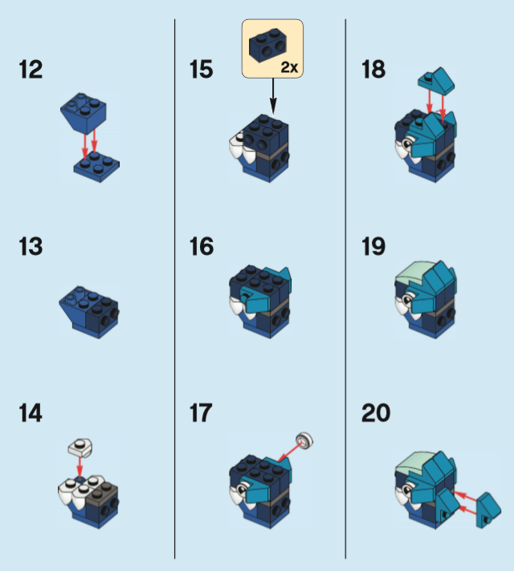
The Future Of Simple Programming
Andrew Gleadall Principal Engineer
@gleadaa

Slide 2
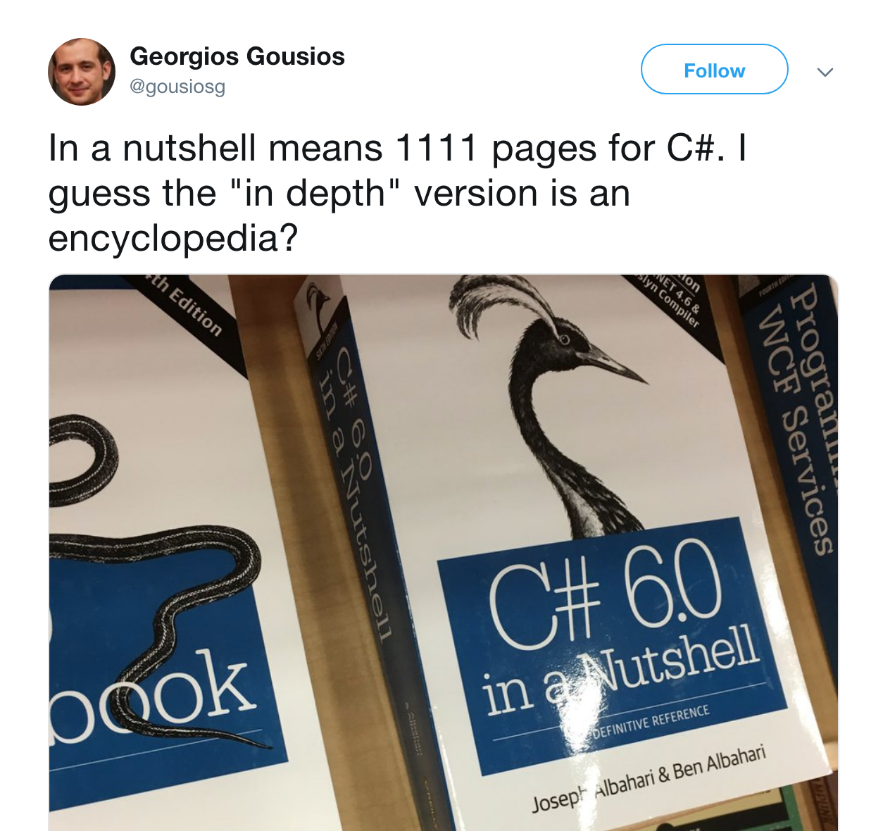
The current state of programming
Notes:
Before I talk about the future, let’s just think about the status quo. Programming is a complicated business. Because we do it everyday and we are immersed in it, It’s hard for us professionals to really understand the depth of knowledge required to be proficient at programming.
For example, consider if I sat my 13 year old son down and told him we are going to develop a program together in C# and WPF. That would be a very serious undertaking, I’d have to explain a fair amount of those 1100 pages before we even get on to WPF. It’s very complicated, the question is really, does it really need to be this complex?

Slide 3

A vision of the future
“Oh man, C# is really blowing my mind, it’s very complicated and I’m finding it difficult to learn.”
“You should use this new language. It’s so much simpler but also fully featured.”
“As a young person in a tech company I’m happy to learn something new and better. Thanks for the tip!”
Notes:
The trajectory of C# and many other programming languages is towards more and more complex features. There’s speculation that many mainstream programming languages will converging on the same broad set of features. That’s the direction we have been travelling in for some time, but I wonder if there was another path we could take.
Could we allow people to do the sorts of things they do now with simpler tools?
I have this romantic, optimistic, vision of the future and it’s one where we have turned back from this path towards increasing complexity.

Slide 4

Opportunity
Can I create a new programming language that satisfies that vision?

Slide 5
Primary design goals
Notes:
If I was to create a new programming language, what would the design goals be?

Slide 6
Primary design goals
Fully Featured
Notes:
There’s no point coming up with a new programming language that’s missing features that people want to use.

Slide 7
Primary design goals
Fully Featured
Simple
Notes:
Simple: LEGO bricks, I’ve chosen a LEGO instruction manual as the background image because I feel a bit like writing software ought to be a more like building something out of LEGO, where the the component parts from fairly regular shapes and they click together in simple, standardised ways.

Slide 8
Secondary design goals
Notes:
Below that we have some practical considerations.

Slide 9
Secondary design goals
Portable
Compiles to JavaScript and can run in node.js on many platforms and in browsers

Slide 10
Secondary design goals
Portable
Compiles to JavaScript and can run in node.js on many platforms and in browsers
Familiar
Similar syntax to JavaScript/C-style languages
Notes:
I don’t think there’s much of a market for a completely alien, un-JavaScript like, kind of programming language that compiles to JavaScript. If the language compiles to JavaScript then JavaScript users are probably the people who will be most interested in it, so that’s why I’ve chosen to make the syntax very JavaScript like.

Slide 11
Tertiary design goals
Notes:
After considering practical matter, then started to fantasize about some far out and far off ideas.

Slide 12
Tertiary design goals
Homoiconicity
Notes:
What else would my dream language have?
One thing I’d love the language to have is homoiconicity. If you look on the internet you’ll find there’s some debate as to what homoiconicity means. I’ll give you a purely practical definition borrowed from wikipedia.

Slide 13
Tertiary design goals
Homoiconicity
Wikipedia: "In homoiconic languages, all code can be accessed and transformed as data, using the same representation."
Notes:
The key point is that last condition, using the same representation. What this means is having ’eval’ or an AST parser library in your langauge doesn’t make it homoiconic because the code and the string or the AST representations are different.
If this was a film we would now cut away to my back-story. In my first job, I wrote an expert system. The idea was the customer would install a data collection agent on all their computers and every night a data set would be sent our severs. My expert system would look at the data and say things like: “You are starting to get read errors from your hard disk drive and this can be a precursor to disk drive failure.” The expert system consisted of a set of rules along those lines.
I wrote the expert system in Prolog, and because Prolog is homoiconic, I was able to examine the rule set and progressively generalise the rules in it such that if people encountered errors from their disk drives that we had never seen before, we would still be able to say: “This might be a precursor to disk drive failure.”. It sounds incredible but it was actually something like 15 lines of prolog to make that happen.
You can only do that kind of thing if that the language you are using is homoiconic. When I daydream of a super new programming language, homoiconicity, is one of the major features I’d like to have.

Slide 14
Introducing…
Notes:
Those are the design goals, does that sound like something you’d be interested in?
Quick show of hands. Who’s interested?
Well, this isn’t just something I’ve been thinking idly about. I’ve actually been working on a language, and I’d like to introduce it to you today.

Slide 15
The To Do List
Notes:
OK, so before I continue, I just want to set your expectations appropriately. I’m about 90-95% done. There’s just a few things still left to do.

Slide 16
To Do List: Access Modifiers
Notes:
I’m just going to go through a few items off the To Do list…

Slide 17
To Do List: Access Modifiers
Readonly
Notes:
You can’t mark the data members of objects as read only.

Slide 18
To Do List: Access Modifiers
Readonly
Sealed
Notes:
You can’t seal a class to prevent it being sub-classed.

Slide 19
To Do List: Access Modifiers
Readonly
Sealed
Internal
Notes:
You can’t limit access to class members to only being accessed from your program boundaries.

Slide 20
To Do List: Access Modifiers
Readonly
Sealed
Internal
Protected
Notes:
You can’t limit access to only subclasses

Slide 21
To Do List: Access Modifiers
Readonly
Sealed
Internal
Protected
Private
Notes:
You can’t limit access to class members

Slide 22
To Do List: Access Modifiers
Readonly
Sealed
Internal
Protected
Private
Access modifiers
Notes:
I’m going to be honest with you, there’s no support for any kind of access modifier.

Slide 23
To Do List: Classes, Interfaces

Slide 24
To Do List: Classes, Interfaces
Extension methods
Notes:
You can’t extend a class by defining methods outside the definition of that class.

Slide 25
To Do List: Classes, Interfaces
Extension methods
Multiple inheritance

Slide 26
To Do List: Classes, Interfaces
Extension methods
Multiple inheritance
Inheritance
Notes:
You can’t inherit from other classes.

Slide 27
To Do List: Classes, Interfaces
Extension methods
Multiple inheritance
Inheritance
Abstract classes
Notes:
You can’t have a class marked as abstract that contains some implemented methods in it.

Slide 28
To Do List: Classes, Interfaces
Extension methods
Multiple inheritance
Inheritance
Abstract classes
Interfaces

Slide 29
To Do List: Classes, Interfaces
Extension methods
Multiple inheritance
Inheritance
Abstract classes
Interfaces
Classes
Notes:
You can’t define a class.

Slide 30
To Do List: Classes, Interfaces
Extension methods
Multiple inheritance
Inheritance
Abstract classes
Interfaces
Classes
Create objects with ‘new’ keyword
Notes:
You can’t create objects with the new keyword.

Slide 31
To Do List: Classes, Interfaces
Extension methods
Multiple inheritance
Inheritance
Abstract classes
Interfaces
Classes
Create objects with ‘new’ keyword
Classes, Interfaces
Notes:
I’ll be honest with you, you can’t use classes or interfaces at all.

Slide 32
To Do List: Exceptions

Slide 33
To Do List: Exceptions
Finally clause in try/catch expressions
Notes:
There’s no finally clause implemented yet.

Slide 34
To Do List: Exceptions
Finally clause in try/catch expressions
Else clause in try/catch expressions
Notes:
Same for the else clause

Slide 35
To Do List: Exceptions
Finally clause in try/catch expressions
Else clause in try/catch expressions
Catch clause in try/catch expressions
Notes:
You can’t actually catch expressions with the catch keyword yet.

Slide 36
To Do List: Exceptions
Finally clause in try/catch expressions
Else clause in try/catch expressions
Catch clause in try/catch expressions
Try clause in try/catch expressions
Notes:
The try clause, I haven’t done that yet either.

Slide 37
To Do List: Exceptions
Finally clause in try/catch expressions
Else clause in try/catch expressions
Catch clause in try/catch expressions
Try clause in try/catch expressions
Throw exceptions
Notes:
You can cause exceptions, You can’t throw exceptions with the throw keyword, I haven’t done that yet.

Slide 38
To Do List: Exceptions
Finally clause in try/catch expressions
Else clause in try/catch expressions
Catch clause in try/catch expressions
Try clause in try/catch expressions
Throw exceptions
Exceptions
Notes:
I’ll be honest with you, you can’t really use exceptions.

Slide 39
To Do List: Jump statements
Goto statements
Notes:
Goto statements are “considered harmful”, so they aren’t in yet.

Slide 40
To Do List: Jump statements
Goto statements
Break statements
Notes:
You can’t break out of a loop.

Slide 41
To Do List: Jump statements
Goto statements
Break statements
Continue statements
Notes:
You can’t end the current iteration of a loop with continue.

Slide 42
To Do List: Jump statements
Goto statements
Break statements
Continue statements
Return statements
Notes:
You can’t return early with the return statement.

Slide 43
To Do List: Jump statements
Goto statements
Break statements
Continue statements
Return statements
Jump statements
Notes:
I’ll be honest with you, you can’t really do any kind of jumping.

Slide 44
To Do List: Looping

Slide 45
To Do List: Looping
List comprehensions
Notes:
List comprehensions are a way of creating a list and populating them in the same statement. You can’t yet do that.

Slide 46
To Do List: Looping
List comprehensions
Do … until loops

Slide 47
To Do List: Looping
List comprehensions
Do … until loops
Do … while loops
Notes:
What I’m saying here is that you can’t have the exit check at the end of your loops.

Slide 48
To Do List: Looping
List comprehensions
Do … until loops
Do … while loops
While loops
Notes:
Strictly speaking you can’t use while loops.

Slide 49
To Do List: Looping
List comprehensions
Do … until loops
Do … while loops
While loops
Foreach loops

Slide 50
To Do List: Looping
List comprehensions
Do … until loops
Do … while loops
While loops
Foreach loops
For loops

Slide 51
To Do List: Looping
List comprehensions
Do … until loops
Do … while loops
While loops
Foreach loops
For loops
Looping
Notes:
I’ll be honest with you, there’s no support for loops.

Slide 52
To Do List: Branching

Slide 53
To Do List: Branching
Switch statements
Notes:
Can’t quite make my mind up how I’d like the syntax for switch statements, so I’ve not implemented those yet.

Slide 54
To Do List: Branching
Switch statements
Ternary operator

Slide 55
To Do List: Branching
Switch statements
Ternary operator
Else clauses of if statements

Slide 56
To Do List: Branching
Switch statements
Ternary operator
Else clauses of if statements
Then clauses of if statements

Slide 57
To Do List: Branching
Switch statements
Ternary operator
Else clauses of if statements
Then clauses of if statements
If statements
Notes:
I’ll be honest with you, you can’t really use if statements.

Slide 58
To do list: Mathematical operators

Slide 59
To do list: Mathematical operators
Increment operator (++)
Notes:
You can’t use the increment in prefix or postfix form. Same for decrement operator.

Slide 60
To do list: Mathematical operators
Increment operator (++)
Modulo operator (%)

Slide 61
To do list: Mathematical operators
Increment operator (++)
Modulo operator (%)
Power of operator (** or ^)

Slide 62
To do list: Mathematical operators
Increment operator (++)
Modulo operator (%)
Power of operator (** or ^)
Integer division operator (//)

Slide 63
To do list: Mathematical operators
Increment operator (++)
Modulo operator (%)
Power of operator (** or ^)
Integer division operator (//)
Division (/)

Slide 64
To do list: Mathematical operators
Increment operator (++)
Modulo operator (%)
Power of operator (** or ^)
Integer division operator (//)
Division (/)
Multiplication (*)

Slide 65
To do list: Mathematical operators
Increment operator (++)
Modulo operator (%)
Power of operator (** or ^)
Integer division operator (//)
Division (/)
Multiplication (*)
Addition (+)

Slide 66
To do list: Mathematical operators
Increment operator (++)
Modulo operator (%)
Power of operator (** or ^)
Integer division operator (//)
Division (/)
Multiplication (*)
Addition (+)
Subtraction (-)

Slide 67
To do list: Mathematical operators
Increment operator (++)
Modulo operator (%)
Power of operator (** or ^)
Integer division operator (//)
Division (/)
Multiplication (*)
Addition (+)
Subtraction (-)
Mathematical operators
Notes:
I’m going to be honest with you, you can’t use any kind of mathematical operator.

Slide 68
To Do List: Equality operators

Slide 69
To Do List: Equality operators
Greater than equals (>=)

Slide 70
To Do List: Equality operators
Greater than equals (>=)
Less than equals (<=)

Slide 71
To Do List: Equality operators
Greater than equals (>=)
Less than equals (<=)
Greater than (>)

Slide 72
To Do List: Equality operators
Greater than equals (>=)
Less than equals (<=)
Greater than (>)
Less than (<)

Slide 73
To Do List: Equality operators
Greater than equals (>=)
Less than equals (<=)
Greater than (>)
Less than (<)
Not equal (!=)

Slide 74
To Do List: Equality operators
Greater than equals (>=)
Less than equals (<=)
Greater than (>)
Less than (<)
Not equal (!=)
Equal (==)

Slide 75
To Do List: Equality operators
Greater than equals (>=)
Less than equals (<=)
Greater than (>)
Less than (<)
Not equal (!=)
Equal (==)
Strict equal (===)

Slide 76
To Do List: Equality operators
Greater than equals (>=)
Less than equals (<=)
Greater than (>)
Less than (<)
Not equal (!=)
Equal (==)
Strict equal (===)
Equality operators
Notes:
I’m going to be honest with you, you can’t use any kind of equality operator

Slide 77
To Do List: Logical operators

Slide 78
To Do List: Logical operators
The OR operator (||)

Slide 79
To Do List: Logical operators
The OR operator (||)
The AND operator (&&)

Slide 80
To Do List: Logical operators
The OR operator (||)
The AND operator (&&)
The NOT operator (!)

Slide 81
To Do List: Logical operators
The OR operator (||)
The AND operator (&&)
The NOT operator (!)
Logical operators
Notes:
I’ll be honest with you, you can’t use any kind of logical operator.

Slide 82
To Do List: The dot operator

Slide 83
To Do List: The dot operator
Writing properties with the dot operator (.)

Slide 84
To Do List: The dot operator
Writing properties with the dot operator (.)
Reading properties with the dot operator

Slide 85
To Do List: The dot operator
Writing properties with the dot operator (.)
Reading properties with the dot operator
Calling methods with the dot operator

Slide 86
To Do List: The dot operator
Writing properties with the dot operator (.)
Reading properties with the dot operator
Calling methods with the dot operator
The dot operator
Notes:
I’ll be honest with you, you can’t use the dot operator to do anything.

Slide 87
To Do List: Syntax
Notes:
???

Slide 88
To Do List: Syntax
Variadic arguments
Notes:
You can’t have statements that accept any number of arguments.

Slide 89
To Do List: Syntax
Variadic arguments
Spread operator (…)
Notes:
You can’t pack and unpack lists using the spread operator, there’s no spread operator.

Slide 90
To Do List: Syntax
Variadic arguments
Spread operator (…)
Code blocks with curly braces
Notes:
Although you can define objects using curly braces, you can’t have blocks of code defined with curly braces.

Slide 91
Introducing…
Notes:
There’s more to the to-do list than that but to speed things along I’m going to stop there.
This is a massive, exciting moment for me. This is the first time I’ve revealed in public on what I’ve been working so hard on. I’d like to introduce…

Slide 92
Bugs
Notes:
There’s a few bugs in the AST parser. I really thought I would get to the bottom of what’s going on in time before this talk but, AST parsers are really tricky things.
I’ll just quickly read out the details of the bugs because it affects what you can currently do.

Slide 93
Bugs
BUG-001: As a keen developer and early adopter with an important and imminent deadline, I would like the assignment operator to work for Ints.

Slide 94
Bugs
BUG-001: As a keen developer and early adopter with an important and imminent deadline, I would like the assignment operator to work for Ints.
BUG-002: As a keen developer, I would like the assignment operator to work for Strings.

Slide 95
Bugs
BUG-001: As a keen developer and early adopter with an important and imminent deadline, I would like the assignment operator to work for Ints.
BUG-002: As a keen developer, I would like the assignment operator to work for Strings.
BUG-003: The assignment operator doesn’t work for Arrays

Slide 96
Bugs
BUG-001: As a keen developer and early adopter with an important and imminent deadline, I would like the assignment operator to work for Ints.
BUG-002: As a keen developer, I would like the assignment operator to work for Strings.
BUG-003: The assignment operator doesn’t work for Arrays
BUG-004: = broken for Objects

Slide 97
Introducing…
Notes:
OK, look, when I proposed this talk, I thought I would be able to get much, much more done. I just haven’t had the time.
Anyway, so I’m here now and you’re here so we might as well carry on.

Slide 98
FFS Script
Notes:
I couldn’t think of good name so my working title for the language is FFS Script. FFS because the primary design goals are 1). Fully Featured and 2). Simple.
I’m still absolutely convinced that FFS Script is the programming language of the future.
I will introduce you to it by going through a couple of interview style coding challenges, that’s going to give you a massive advantage when those very highly paid FFS Script jobs start appearing.

Slide 99
FizzBuzz
"Write a program that prints the numbers from 1 to 100. But for multiples of three print “Fizz” instead of the number and for the multiples of five print “Buzz”. For numbers which are multiples of both three and five print “FizzBuzz”."
Notes:
Let’s have a look at a way of doing it in JavaScript.

Slide 100
Notes:
Switch to VS Code for live coding

Slide 101
Marking My Own Homework

Slide 102
Marking My Own Homework
Fully Featured

Slide 103
Marking My Own Homework
Fully Featured
Simple

Slide 104
Marking My Own Homework
Fully Featured
Simple
Portable

Slide 105
Marking My Own Homework
Fully Featured
Simple
Portable
Homoiconic

Slide 106
Marking My Own Homework
Fully Featured
Simple
Portable
Homoiconic (ish)

Slide 107
Marking My Own Homework
Fully Featured
Simple
Portable
Homoiconic (ish)
Gave a talk about Functional Programming without using the F-word

Slide 108

Marking My Own Homework
Fully Featured
Simple
Portable
Homoiconic (ish)
Gave a talk about Functional Programming without using the F-word

